Slide 1
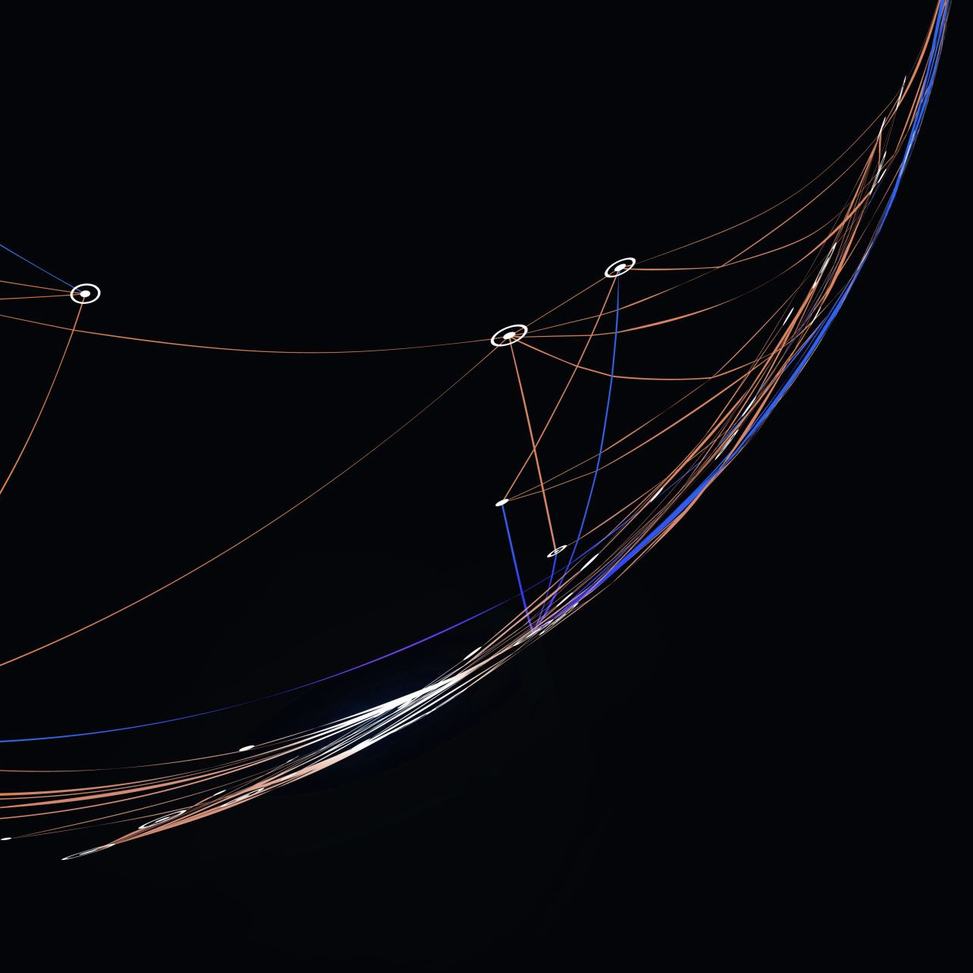
Azure Kubernetes Workshop
Day 3:
Advance Kubernetes Concepts

Slide 2
Agenda
Node Affinity , Pod Affinity, Pod Topology Spread Constraints
Taints and Tolerations
Request and Limits
Limit Ranges and Resource Quotas
Pod Disruption Budget
Monitoring and observability in Kubernetes with Azure Monitor and Prometheus
Autoscaling in Kubernetes: Horizontal Pod Autoscaler (HPA) and KEDA
Network Policies for network segmentation and security
ACA/ACI

Slide 3
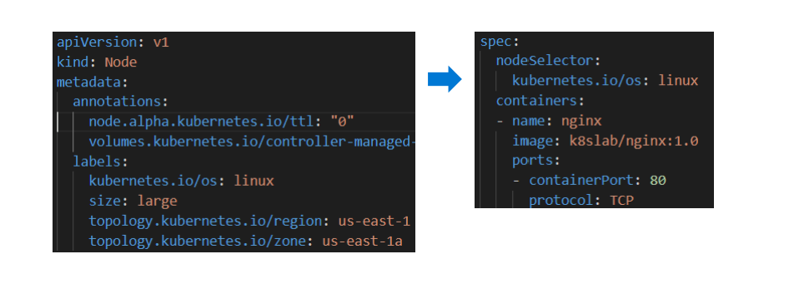
Node Selectors / Node Affinity
Pods can use Node labels to specify which Nodes to be scheduled on.
Labels must be on the Nodes prior to deploying Pods selecting the Nodes.
If selected Node label is not found on any node, Pods will not get scheduled.

Slide 4
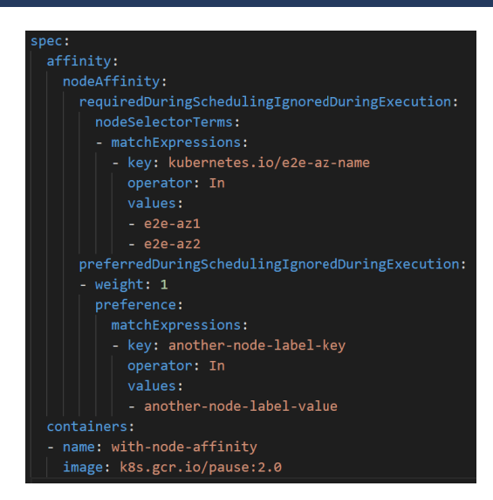
Node Affinity
The affinity/anti-affinity language is more expressive. The language offers more matching rules besides exact matches created with a logical AND operation
Can indicate that the rule is soft "preference" rather than a hard requirement, so if the scheduler can't satisfy it, the Pod will still be scheduled.
Use weight to set preference order.
Notes:
Require that Kubernetes scheduler matches a pod with a labeled host. Or,
Prefer a match but allow the pod to be scheduled on a different host if no match is available.
The IgnoredDuringExecution part of the setting indicates that the pod shouldn't be evicted from the node if the node labels change

Slide 5
Taints and Tolerations
Since a cluster can be a collection of heterogenous nodes, sometimes it makes sense to set a policy restricting which Pods are scheduled on which Nodes.
Nodes can be marked as “tainted” with particular attributes
Pods can be designated as being able to “tolerate” certain taints
Depending on the taint-effect, the scheduler will decide if a Pod can be scheduled on a tainted Node.
Node taint-effects can be:
NoSchedule – New Pods will NOT be scheduled on the tainted node unless they can tolerate the taint
PreferNoSchedule – Pods CAN be scheduled ONLY IF they won’t fit on any other node.
NoExecute – New Pods will NOT be scheduled on the tainted node and existing Pods without toleration will be EVICTED from a tainted node

Slide 6
Taints and Tolerations
kind: Pod
apiVersion: v1
metadata:
name: tf-mnist
spec:
containers:
- name: tf-mnist
image: mcr.microsoft.com/azuredocs/samples-tf-mnist-demo:gpu
resources:
requests:
cpu: 0.5
memory: 2Gi
limits:
cpu: 4.0
memory: 16Gi
tolerations:
- key: "sku"
operator: "Equal"
value: "gpu"
effect: "NoSchedule"
az aks nodepool add \
--resource-group myResourceGroup \
--cluster-name myAKSCluster \
--name taintnp \
--node-taints sku=gpu:NoSchedule \
--no-wait

Slide 7
Taints and Tolerations with Node Selectors/Affinity
Adding tolerations to Pod for tainted Nodes does NOT guarantee those Pods will be scheduled those tainted Node.
Taints, Tolerations and Node Selectors/Affinity can be used together to achieve complex results.
Example: You want certain Pod to be scheduled on specific types of Nodes and you don’t want other types of Pods on those same Nodes:
Add labels to the Nodes specifying a special attribute
Add taints to the Nodes to keep out intolerant Pods
Add tolerations to your Pods to tolerate the taints
Add a Node Selector or Affinity to your Pods that select matching node labels.
Results: Only desired Pods will be scheduled on the tainted Nodes

Slide 8
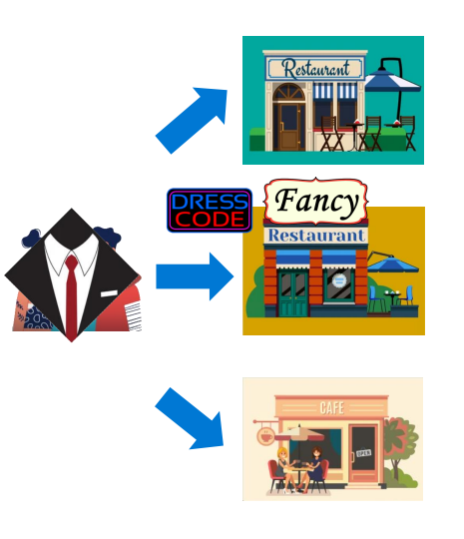
Non-Technical Example
You and your friends (containers in a pod) want to go out to dinner.
You have 3 restaurants (nodes) to choose from.
One restaurant puts up a sign (label) saying they’re a Fancy restaurant.
The Fancy restaurant adds a dress code (taint) and does not allow customers inside (NoSchedule) who are not properly attired. Most customer decide to go elsewhere.
You and your friends put on nice clothes (tolerations) so you can enter fancy restaurants.
However, there’s nothing to say that you must go to a fancy restaurant. You can go anywhere.
You and your friends want to only go to fancy restaurants (node selector/affinity).

Slide 9
Node Selectors, Taints and Tolerations Demo
Coordinating Workloads using Node Selectors, Taints and Tolerations

Slide 10
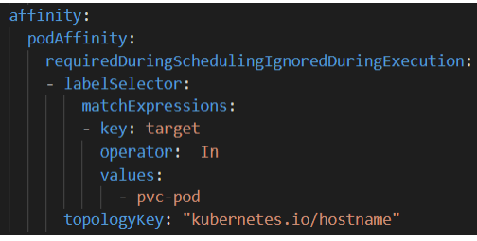
Pod Affinity/Anti-Affinity
Uses Labels Selectors that match labels on other Pods.
Not recommend on large clusters (over several hundred Nodes)
Requires nodes to be consistently labeled using Well-Known Labels of a topologyKey.
Notes:
Inter-pod affinity allows you to specify rules that dictate which nodes your pods should be scheduled on based on the presence of other pods. For example, you might use inter-pod affinity to ensure that your web server pods are scheduled on nodes that also have your database pods running.
Anti-affinity, on the other hand, allows you to specify rules that dictate which nodes your pods should not be scheduled on based on the presence of other pods. For example, you might use anti-affinity to ensure that your database pods are not scheduled on the same node as your web server pods, in order to prevent resource contention and improve reliability.
A topology domain is a grouping of nodes based on a specific attribute. We're also specifying a `topologyKey` of "kubernetes.io/hostname", which means that we're using the hostname of the node as the topology domain to evaluate our constraints.

Slide 11
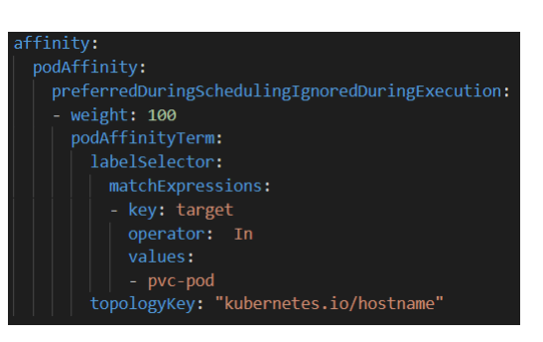
Actions for Affinity
Required During Scheduling Ignored During Execution – Will not schedule new non-matching Pods but will leave existing Pods running.
Preferred During Scheduling Ignored During Execution – Will schedule new nonmatching Pods if there’s no room anywhere else. Use weight to set preference order.
FUTURE: Required During Scheduling Required During Execution – Will evict non-matching Pods

Slide 12
Pod Affinity/Anti-Affinity Demo
Working with Pod Affinity when Scaling Deployments and StatefulSets
Module6-instructions:
Exercise: Using Taints, Tolerations, Node Selectors and Affinity
Notes:
Module6-instructions:
Exercise: Using Taints, Tolerations, Node Selectors and Affinity

Slide 13
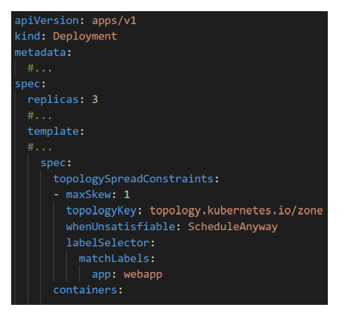
Pod Topology Spread Contraints
Pod topology spread constraints are similar to pod anti-affinity rules but provide more control of Pod distribution across failure topology (nodes, zones, regions).
In addition to the labelSelector, Pod topology spread constraints have the following options:
MaxSkew – Specifies the max difference in Pod counts between topology keys.
TopologyKey – The key of node labels. The scheduler tries to place a balanced number of Pods into each topology domain.
WhenUnsatisfiable – Indicates how to deal with a Pod if it doesn't satisfy the spread constraint (if exceeds MaxSkew):
DoNotSchedule (default) tells the scheduler not to schedule it.
ScheduleAnyway tells the scheduler to still schedule it while prioritizing nodes that minimize the skew
Notes:
Pod topology spread constraints are a feature in Kubernetes that allow you to control how your pods are scheduled on nodes based on their relationships with other pods and the underlying infrastructure.
With pod topology spread constraints, you can specify rules that dictate how many pods of a certain type can be scheduled on a node based on the number of pods of that type that are already running on other nodes. For example, you might use pod topology spread constraints to ensure that no more than 3 web server pods are running on any node in your cluster.
Pod topology spread constraints can help improve the performance and reliability of your applications by ensuring that your pods are distributed evenly across your cluster and are not all running on a single node or set of nodes. This can help prevent resource contention, improve network performance, and reduce the risk of a single point of failure.
`maxSkew` value of 1, which means that the number of web app pods on any node should not be more than one greater than the average number of web server pods across all nodes.
`labelselector`: select only the pods with the labels

Slide 14
Pod Topology Spread Constraints
Observe Event Pod Distribution Across Nodes

Slide 15
StatefulSets
Pod controller designed to manage stateful applications.
Unlike Deployments, a StatefulSet maintain a sticky identity for each of its Pods
Pods are created from the same spec but are not interchangeable
Each Pod has a persistent identifier that it maintains across rescheduling.
Pods are created in order and are assigned sequential numbers, starting with 0…N-1.
Notes:
In Azure Kubernetes Service (AKS), StatefulSets are used to manage stateful workloads that require unique identities and persistent storage, such as databases or other distributed systems. StatefulSets provide several benefits over other types of Kubernetes controllers, including:
Stable network identities: Each pod in a StatefulSet is given a unique hostname and network identity that persists across rescheduling or scaling events.
Ordered deployment and scaling: StatefulSets ensure that pods are deployed and scaled in a predictable, ordered manner, which is important for stateful applications that require initialization or coordination.
Persistent storage: StatefulSets provide support for persistent storage, which allows data to be preserved across pod restarts or rescheduling events
By using StatefulSets in AKS, you can ensure that your stateful workloads are managed in a reliable and predictable manner, with stable network identities and persistent storage that is integrated with the Kubernetes platform.

Slide 16
StatefulSets
StatefulSets define a Volume Claim Templates, which define parameters to use when dynamically creating PersistentVolumeClaims and PersistentVolumes for each Pod.
Pod order and persistent volume claims are maintained when Pods are deleted.
Replacement Pods are linked to the same PVCs.
Deleting Pods in a StatefulSet (or the StatefulSet itself) will not delete the associated volumes. This is by design.

Slide 17
Headless Service
A “headless” service (clusterIP=None) is required for StatefulSets.
The service is referenced by the Pod definition and allows direct access to each without load balancing.
Creates a DNS entry for each Pod instead of just for the Service.
Pods are accessed directly through the headless service using DNS and the FQDN address.
Fully Qualified domain name: {pod}.{service}.{namespace}.svc.cluster.local
Example: mysql.connect(“mysql-02.db-service.micro.svc.cluster.local”)

Slide 18
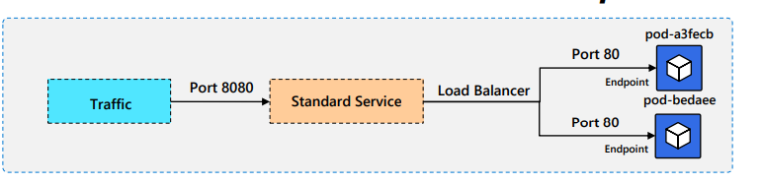
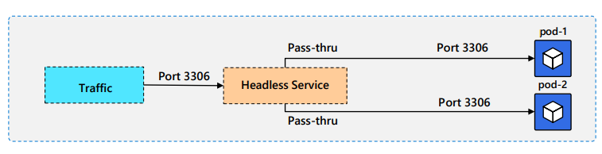
How Headless Services Work
A standard Service load balances traffic across all Pods listed as Endpoints
A Headless Service doesn’t have Endpoints. It routes traffic directly to specific Pods.

Slide 19
StatefulSet Demo
Working with StatefulSets

Slide 20
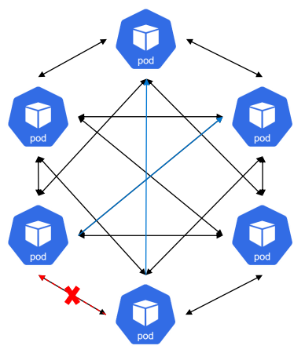
Network Policy
All Pods are accessible by all other pods by defaults. They accept traffic from anyone.
A Network Policy is an application-centric construct which allows you to specify how a pod is allowed to communicate with various network "entities“ over the network.
When Network Policies are in place, Pods will reject connections not allowed by those Network Policies.
Network Policies use labels to isolate Pods by specifying how traffic flows in (Ingress) and out (egress) of the Pods.

Slide 21
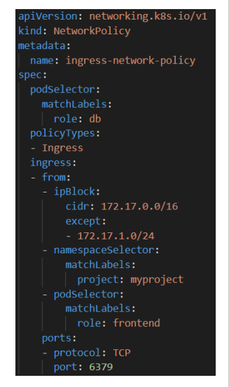
Network Policy Configuration
podSelector: Each NetworkPolicy includes a podSelector which selects the grouping of pods to which the policy applies.
policyTypes: Each NetworkPolicy includes a policyTypes, which indicates whether or not the given policy applies to ingress traffic to selected pod, egress traffic from selected pods, or both.
ingress: Each NetworkPolicy may include a list of allowed ingress rules. Each rule allows traffic which matches both the from and ports sections.

Slide 22
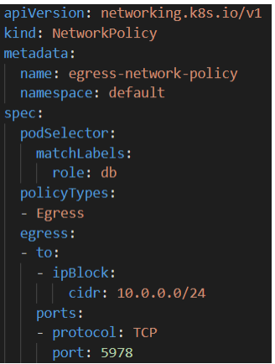
Network Policy Configuration
egress: Each NetworkPolicy may include a list of allowed ingress rules. Each rule allows traffic which matches both the from and ports sections.
ipBlock: This selects particular IP CIDR ranges to allow as ingress sources or egress destinations. These should be cluster-external IPs, since Pod IPs are ephemeral and unpredictable.

Slide 23
AKS Network Policy Options
Network policy is a Kubernetes feature available in AKS that lets you control the traffic flow between pods.
Azure provides two ways to implement network policy. You choose a network policy option when you create an AKS cluster. The policy option can't be changed after the cluster is created:
Azure's own implementation, called Azure Network Policies.
Calico Network Policies, an open-source network and network security solution.
Both implementations use Linux IPTables to enforce the specified policies.
Policies are translated into sets of allowed and disallowed IP pairs, which are then programmed as IPTable filter rules

Slide 24
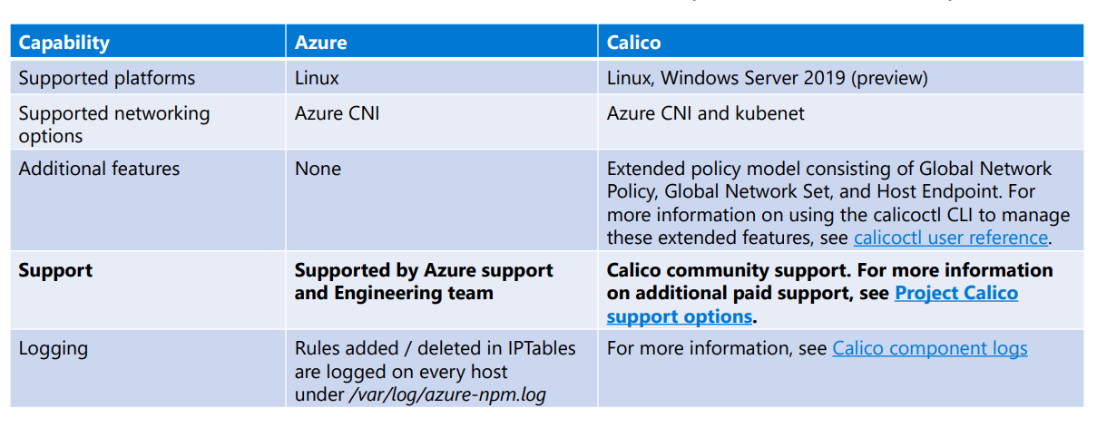
AKS Network Policy Comparison
This table lists differences between Azure and Calico policies and their capabilities:

Slide 25
Network Policy
Network Policy
Notes:
Secure pod traffic with network policy - Azure Kubernetes Service | Microsoft Learn

Slide 26
Request and Limits
Kubernetes Request and Limits

Slide 27

Resources: Virtual Machines
VMs are single, isolated entities residing on the same host
Each VM has its own set of dedicated resources
Think of single houses on a block

Slide 28
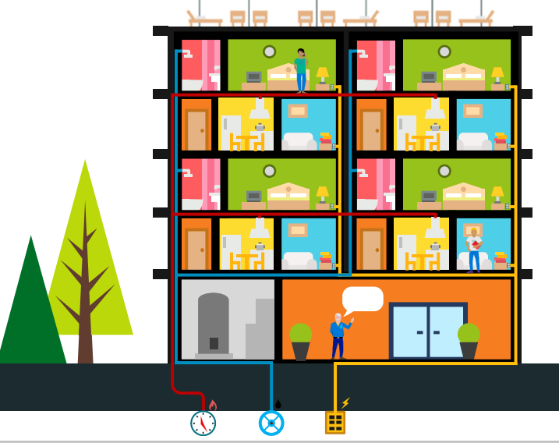
Resources: Containers
Containers share the resources of the VM (Node) they’re running on.
Just like apartments in a building, Containers must contend with others competing for the same set of limited resources.
A good apartment building should be able to limit the amount of resources each tenant can use so that others won’t run out

Slide 29
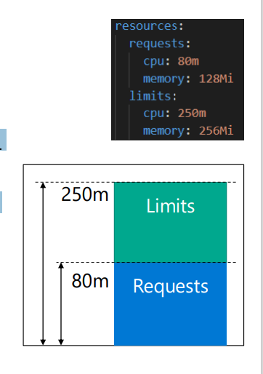
Resources Request and Limits
A Container can request resources, usually for CPU and memory, to be set aside for its use.
A request as the amount of a resource that the Kubernetes will guarantee to the container.
A limit is the maximum amount of a resource that Kubernetes will allow the container to use.
The scheduler uses the requested values to decide which Node to schedule the Pod on.
If the node where a Pod is running has enough of a resource available, it's possible (and allowed) for a container to use more resource than its request for that resource specifies.
However, a container is not allowed to use more than its resource limit.

Slide 30
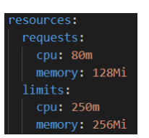
Resources Request and Limits
CPU and memory resources requests and limits are specified as follows:
CPU resources can be specified in terms of milli-cores (1/1000th of a CPU).
For example, cpu: 100m is asking for 1/10th of a CPU core.
Memory requests can be specified in T, G, M, K. You can also use the powerof-two equivalents: Ti, Gi, Mi, Ki.
Example: 256K (kilobytes) = 250Ki (kibibytes)
If a Container specifies a CPU/memory limit, but does not specify a CPU/memory request, Kubernetes automatically assigns a memory request that matches the limit.
If your Pod's containers have no requests or limits, then, by definition, they are using more than they requested, so are prime candidates for termination

Slide 31
Resources Guarantess
Compressible Resource Guarantees:
Kubernetes only supports CPU for now.
Pods will be throttled if they exceed their limit. If limit is unspecified, then the pods can use excess CPU when available.
Incompressible Resource Guarantees:
Kubernetes only supports memory for now.
Pods will get the amount of memory they request, if they exceed their memory request, they could be killed (if some other Pod needs memory), but if pods consume less memory than requested, they will not be killed.
When Pods use more memory than their limit, the process that is using the most amount of memory, inside one of the pod's containers, will be killed by the kernel.

Slide 32
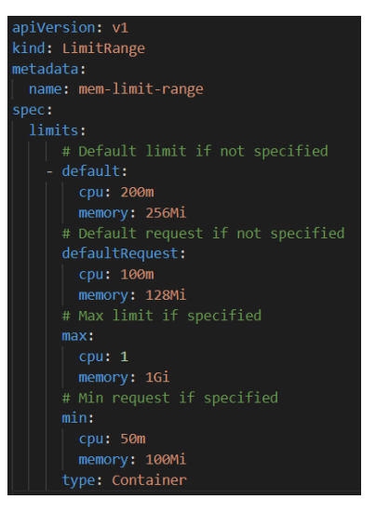
Default Request and Limits
In a large system, it may not be practical to define resource requests/limits for all the existing containers.
The LimitRange object allows you to specify a default set of requests (defaultRequests) and limits (defaults) for any Container created in a Namespace.
When requests/limits are not specified by the Container, the defaults in the LimitRange will be used.
When requests/limits are specified, those values override the defaults in the LimitRange.
The min (requests) and max (limits) can also be specified to ensure values specified for a Container stay within set bounds.

Slide 33
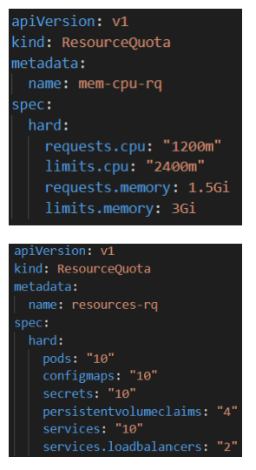
Namespace Resource Quota
A ResourceQuota object, defines constraints that limit aggregate resource (total CPU and memory) consumption per namespace.
A Resource Quota can also limit the quantity of objects that can be created in a namespace by type (max PVCs for example).
Resource Quotas only work if requests and limits specified.
It’s highly recommended to create a LimitRange resource in the same namespace as the ResourceQuota.
Limits should be large enough to accommodate upgrades.

Slide 34
Resource Requests, Limit, Ranges and Quotas
Managing Resource Requests and Limit

Slide 35
AutoScaler
Kubernetes AutoScaler

Slide 36
Quality of Service(QoS) Classes
Kubernetes assigns different levels of Quality of Service (QoS) to Pods depending on their request and limits values.
Kubernetes uses QoS classes to make decisions about scheduling and evicting Pods.
Best-Effort (QoS)
Pods will be treated as lowest priority. Processes in these pods are the first to get killed if the system runs out of memory. Default setting if no requests are specified by any Containers.
Burstable (QoS)
Pods have some form of minimal resource guarantee but can use more resources when available. Under system memory pressure, these containers are more likely to be killed once they exceed their requests.
At least one Container in the Pod has a memory or CPU requests specified.
Guaranteed (QoS)
Pods are considered top-priority and are guaranteed to not be killed until they exceed their limits.
Requests and limits values MUST BE EQUAL!

Slide 37
What Values Request and Limit Should be Used?
Once you realize the benefits of setting requests and limits values for your containers, it’s time to determine which values to use.
Of course, you can make an educated guess. Based on a study done by DataDog*, about 80% of deployments in production specify requests and limits that are significantly smaller or larger than the resources their containers actually use.
Setting request values too high could lead to Node underutilization.
Setting them too low could lead a Node to be over provisioned and would result in evictions and CPU throttling.

Slide 38
Vertical Pod AutoScaler( Add-on)
The Vertical Pod Autoscaler (VPA) (available as a CustomResourceDefinition), can be used to recommend the best values to use for requests and limits, based on the current load on the containers.
These values can then be used in manifest files to ensure these settings are optimal.
But if resource demands changes over time? Should you keep checking the VPA recommendations periodically and update your manifest files accordingly?
The VPA has an Auto mode, which can automatically update the requests and limits settings of Deployments as workload needs change over time.
These updates respect the min/max ranges set in the LimitRange object, if any.

Slide 39
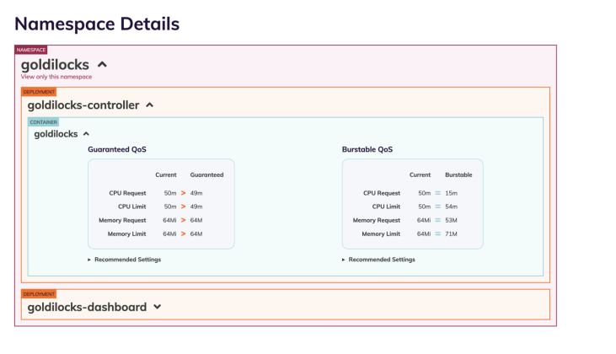
FairWinds Goldilocks
Fairwinds Goldilocks utility provides an implementation of VPA (in manual mode). • Includes a dashboard to monitor usage trends to help determine current resource settings

Slide 40
Horizontal Pod AutoScaler ( Built-in)
Horizontal scaling is the process of increasing/decreasing the number of Pods (replicas) in response to the load on a workload
This is different from vertical scaling, which for Kubernetes would mean assigning more resources (for example: memory or CPU) to the Pods that are already running for the workload. See VPA.
A HorizontalPodAutoscaler automatically updates a workload resource (such as a Deployment or StatefulSet), with the aim of automatically scaling the workload to match demand.
Horizontal Pod autoscaling does not apply to objects that can't be scaled (for example: a DaemonSet.)

Slide 41
Horizontal Pod AutoScaler ( Built-in)
The horizontal pod autoscaler (HPA) uses the Metrics Server in a Kubernetes cluster to monitor the resource demand of pods. If a service needs more resources, the number of pods is automatically increased to meet the demand.
͏HPA obtains resource metrics and compares them to user-specified threshold
2
Node1
Horizontal Pod Autoscaler
Pod
3
Deployment
ReplicaSet
͏HPA evaluates whether user specified threshold is met or not
replicas++
Kubelet
replicas--
4
cAdvisor
Pod
͏HPA increases/decreases the replicas based on the specified threshold
Grabs metrics
NodeX
1
Node2
͏The Deployment controller adjusts the deployment based on increase/decrease in replicas
Metrics Server
Pod
Collects metrics from all containers on the node
Kubelet
Collects metrics from all nodes
cAdvisor

Slide 42
Cluster AutoScaler ( Built-in)
The cluster autoscaler watches for pods that can't be scheduled on nodes because of resource constraints. The cluster then automatically increases the number of nodes.
͏HPA obtains resource metrics and compares them to user-specified threshold
Cluster Autoscaler
Azure
Pod
Pod
2
1
Additional nodes needed
Pods are in pending state
͏HPA evaluates whether user specified threshold is met or not
͏HPA increases/decreases the replicas based on the specified threshold
3
Pending pods are scheduled
Node is granted
4
͏The Deployment controller adjusts the deployment based on increase/decrease in replicas
AKS cluster
Node
Node
Pod
Pod
Pod
Pod

Slide 43
Horizontal Pod Autoscaler Demo
Automatically scales replicas based on CPU or Memory thresholds

Slide 44
Scaling
Kubernetes Event Driven Autoscaling( KEDA)

Slide 45
Kubernetes Event Driven Autoscaling ( KEDA)
KEDA is a single-purpose and lightweight component that can be added into any Kubernetes cluster.
KEDA works alongside standard Kubernetes components like the Horizontal Pod Autoscaler and can extend functionality without overwriting or duplication.
With KEDA you can explicitly map the apps you want to use event-driven scale, with other apps continuing to function.
This makes KEDA a flexible and safe option to run alongside any number of any other Kubernetes applications or frameworks.

Slide 46
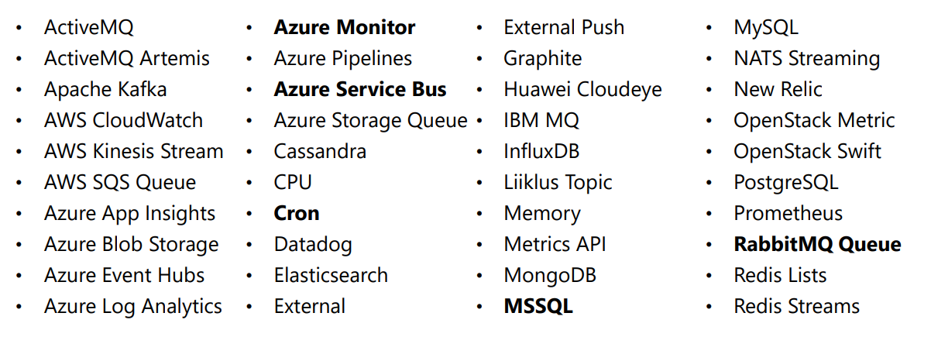
KEDA Scaler
Here’s a partial list of KEDA scalers (external event sources) currently supported, with additional ones added with almost every update.
Scalers

Slide 47
KEDA Demo
Automatically scales replicas based on External metrics like RabbitMQ

Slide 48
Pod Disruptions
There are two types of disruptions that can remove a running Pod:
Involuntary Disruptions – Possible causes:
A hardware failure of the physical machine backing the node
Cluster administrator deletes VM (instance) by mistake
Node disappears from the cluster due to cluster network partition
Eviction of a pod due to the node being out-of-resources.
Voluntary Disruptions – Possible causes:
Deleting the deployment or other controller that manages the Pod
Updating a deployment's pod template causing a restart
Draining a node for repair or upgrade.
Draining a node from a cluster to scale the cluster down (Cluster Autoscaling).
Removing a pod from a node to permit something else to fit on that node

Slide 49
Pod Disruptions Budget (PDB)
Kubernetes offers features to help you run highly available applications even when you introduce frequent voluntary disruptions.
You can create PodDisruptionBudgets (PDB) to protected applications from voluntary disruptions.
PDBs limits the number of Pods of a replicated application that are down simultaneously when node are intentionally taken offline.
PDBs DO NOT protect pods from involuntary disruptions!

Slide 50
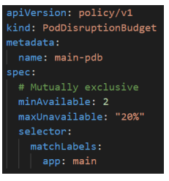
Pod Disruptions Budget (PDB) Configurations
PDBs have only 2 settings:
Selector – Specifies the labels of the Pods to limit.
Disruption Budget:
maxUnavailable – Maximum number (or percentage) of Pods that can be unavailable at any time.
minAvailable – Minimum number (or percentage) of Pods that must be always available.
One budget is required, both are not allowed.
maxUnavailable in a Deployment dictates Pod behavior when a Pod rollout occurs.
maxUnavailable in a PodDisruptionBudget dictates Pod behavior when a Node rollout occurs.

Slide 51
Node Pool Upgrade Demo with PDBs
Update Node Pool Images with PDBs in place

Slide 52
Service Mesh
Open Service Mesh ( OSM)

Slide 53
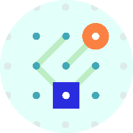

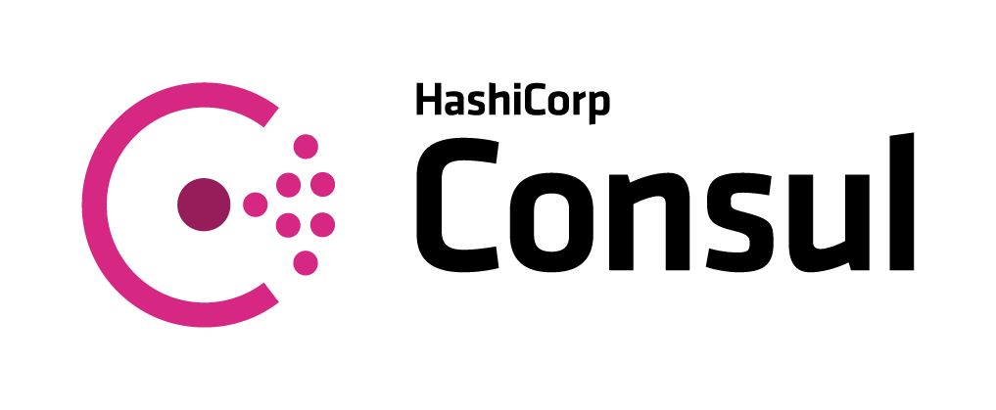

Open Service Mesh ( OSM)
SMI defines a set of APIs that can be implemented by individual mesh providers. Service meshes and tools can either integrate directly with SMI or an adapter can consume SMI and drive native mesh APIs.
​Standard interface for service mesh on Kubernetes​
​Basic feature set to address most common scenarios​
​Extensible to support new features as they become widely available
Apps
Tooling
Ecosystem
Service Mesh Interface
Routing
Telemetry
Policy
…and more
Kubernetes

Slide 54
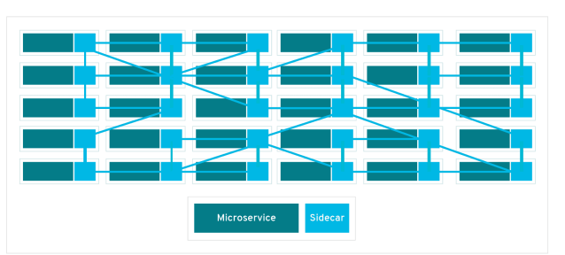
Open Service Mesh ( OSM)
Open Service Mesh (OSM) takes a simple approach for users to uniformly manage, secure, and get out-of-the box observability features for highly dynamic microservice environments.
Using the CNCF Envoy project, OSM implements Service Mesh Interface (SMI) for securing and managing your microservice applications.
OSM uses the Envoy project to implement the Sidecar pattern.
It automatically injects an Envoy container into every Pod scheduled in a namespace managed by OSM.

Slide 55
Open Service Mesh Features
Major OSM features include:
Secure service to service communication by enabling mTLS.
Define and execute fine grained access control policies for services.
Easily and transparently configure traffic shifting for deployments (Canary).
Observability and insights into application metrics for debugging and monitoring services.
Onboard applications onto the mesh by enabling automatic sidecar injection of Envoy proxy.
Easily integrates with Azure Kubernetes Service.

Slide 56
Installing OSM
First, download the Open Service Mesh the OSM command-line tool and copy to a folder in your path.
Then install OSM on to your AKS cluster, using one of two methods:
Method #1 - Enable the AKS add-on (installs into kube-system namespace):
Az aks enable-addons -g resGroup -n clusterName –-addons open-service-mesh
Method # 2 – Use the OSM command-line tool:
osm install -–mesh-name “osm” -–osm-namespace “osm-system”
Finally, add the namespace(s) you want OSM to manage:
osm namespace add chained-osm

Slide 57
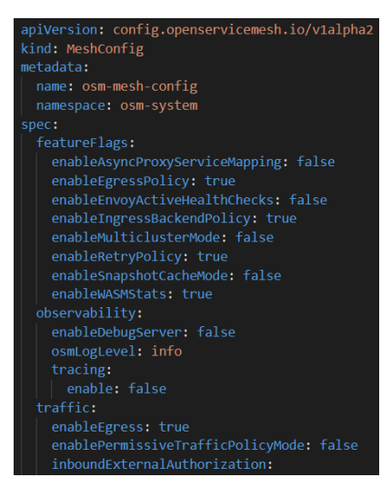
Configuring OSM
OSM uses a custom configuration resource to determine its behavior.
To edit the OSM configuration at:
kubectl edit meshconfig osm-mesh-config -n kube-system
Some important settings include:
enableIngressBackendPolicy
enablePermissiveTrafficPolicyMode
enableEgress
enableEgressPolicy
Notes:
kubectl edit meshconfig osm-mesh-config -n kube-system

Slide 58
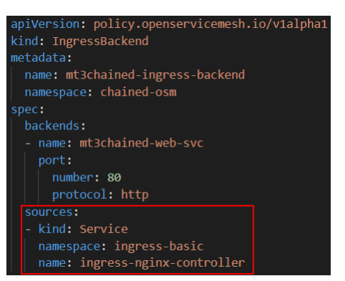
OSM – Ingress Backend
Once OSM is installed, services will no longer be reachable directly from external IP addresses.
To restrict ingress traffic on backends to authorized clients, we create up the IngressBackend configuration such that only ingress traffic from the endpoints of the Nginx Ingress Controller service can route traffic to the service backend.
To be able to discover the endpoints of this service, we need OSM controller to monitor the corresponding namespace.
However, Nginx must NOT be injected with an Envoy sidecar to function properly.
osm namespace add ingress-basic –mesh-name “osm” --disable-sidecar-injection

Slide 59
OSM – Traffic Management
The traffic policy mode determines how OSM routes application traffic between pods within the service mesh.
OSM supports two distinct traffic policy modes for traffic management:
Permissive traffic policy mode – All traffic is allowed.
SMI traffic policy mode – No traffic is allowed by default.
All traffic is encrypted via mTLS regardless of the traffic policy mode.
Permissive traffic policy mode bypasses SMI traffic access policy enforcement and is suitable in environments where explicitly defining traffic access policies for connectivity between applications is not feasible.
The traffic policy mode can be updated by editing OSM’s config file and setting the value of enablePermissiveTrafficPolicyMode:
kubectl edit meshconfig osm-mesh-config -n kube-system

Slide 60
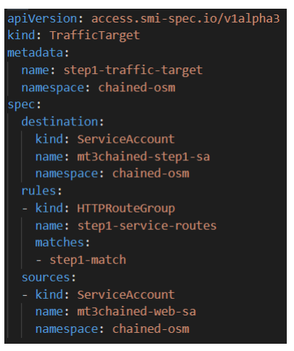
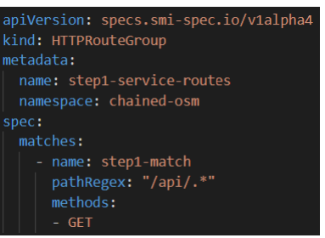
OSM – SMI Traffic Policy Mode
SMI traffic access policy mode is used if Permissive traffic policy mode is disabled (false).
It uses Service Accounts to determine routing permissions between endpoints.
Add a Service Account to each Deployments and then use TrafficTargets to designate those accounts as sources with permission to access the authorized destination.
HTTPRouteGroups are used for fine-grain control over which destinations are accessible and which methods and headers can reach them.

Slide 61
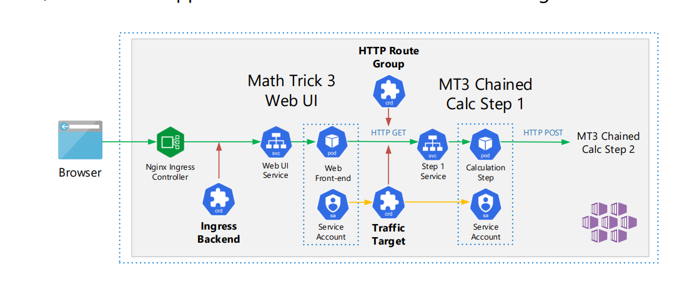
Chained Application Managed by OSM
In OSM, the chained application’s traffic is controlled and managed

Slide 62
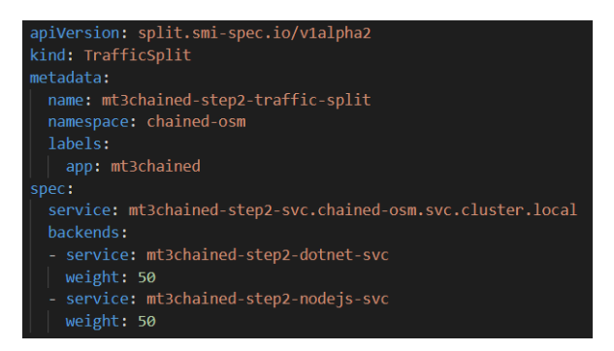
OSM – Traffic Split (Canary Release)
There are times you want to release an update to an application to only a portion of users (maybe only half).
Most ingress controllers support splitting external traffic across multiple services by weight.
This is known as a Canary release.
OSM allow you to perform Canary released internally to your application between microservices.
You can use OSM to split the traffic between several backend endpoints, while preserving the routing configuration between services.

Slide 63
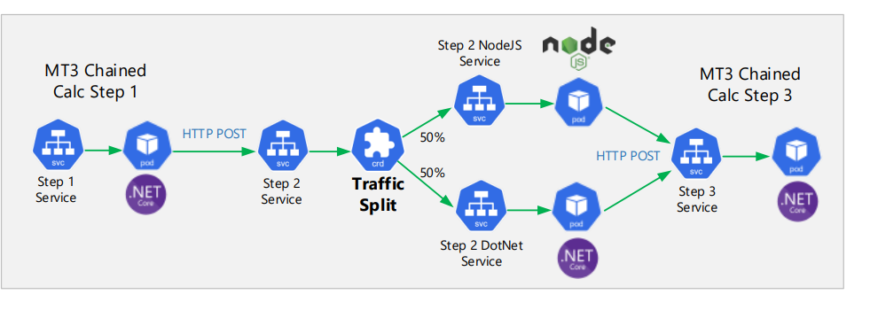
OSM – Traffic Split (Canary Release)
In the sample app, we can split the traffic between 2 different versions of the Step2 microservice, one written in C# .NET and the other written in NodeJS.
By splitting traffic evenly between the two microservices, you can compare their performance against each other

Slide 64
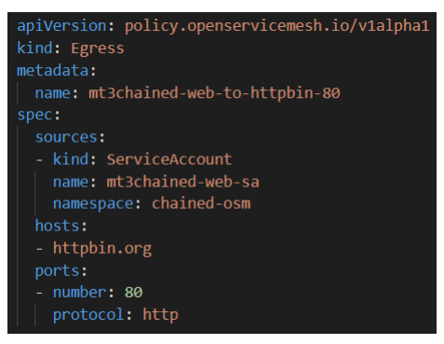
OSM – Egress
OSM allows you to control how cluster services access Internet and external services, referred to as Egress traffic.
OSM redirects all outbound traffic from a Pod within the mesh to the Pod’s sidecar proxy.
There are two mechanisms to configure Egress:
Using the Egress policy API, to provide fine grained access control over external traffic.
Using the mesh-wide global Egress passthrough affects all pods in the mesh (enableEgress in MeshConfig).
When disabled, traffic from pods within the mesh will not be able to access external services outside the cluster

Slide 65
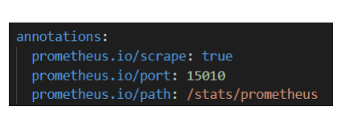
OSM – Observability with Prometheus and Grafana
OSM supports integration with Prometheus and Grafana for observability and monitoring of OSM.
OSM can be configured to send metrics to an existing Prometheus server, or it can deploy its own instance.
Use the CLI to enable metrics for a given namespace:
osm metrics enable --namespace chained-osm
When enabled, the osm-injector adds annotations to all Pods in the namespace.

Slide 66
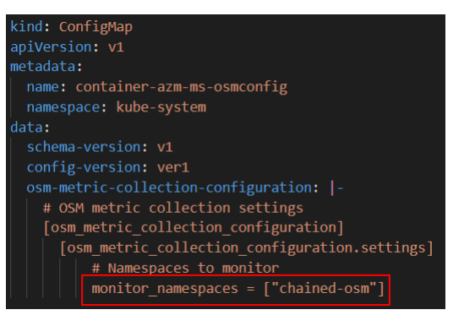
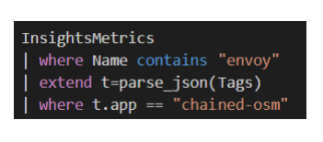
OSM – Observability with Azure Monitor
OSM also supports metrics observability using Azure Monitor.
Metrics must be enabled for the namespace:
osm metrics enable --namespace chained-osm
Create a ConfigMap in the kube-system namespace, enabling Azure Monitor integration with OSM.
Use Kusto to query the metrics in Log Analytics:

Slide 67
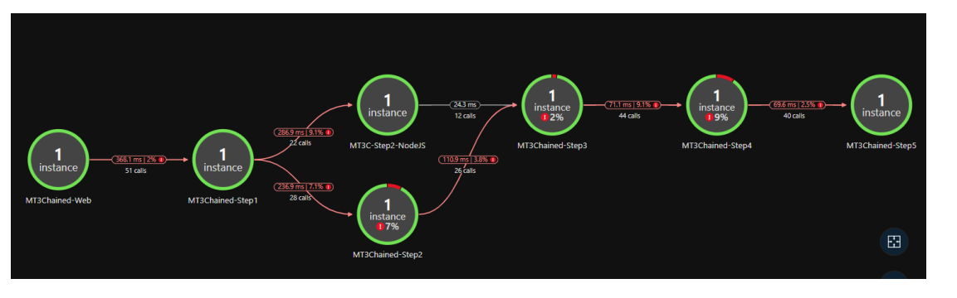
OSM – Observability with Application Insights
As long as Egress traffic is allowed, you can use Application Insights for microservice-level observability and troubleshooting.
Set the APPINSIGHTS_INSTRUMENTATIONKEY environment variable to the iKey of the Application Insights instance.

Slide 68
Open Service Mesh Demo
Management Plane for Kubernetes

